Slide 1

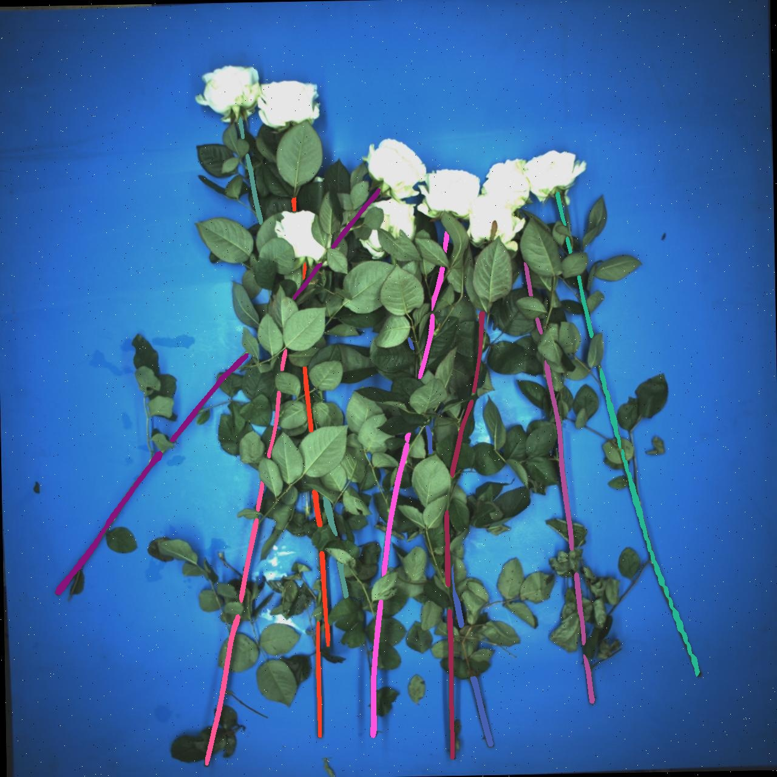
Stem Pairing and Top Flower Selection
Week 13 Hua Jiang

Slide 2
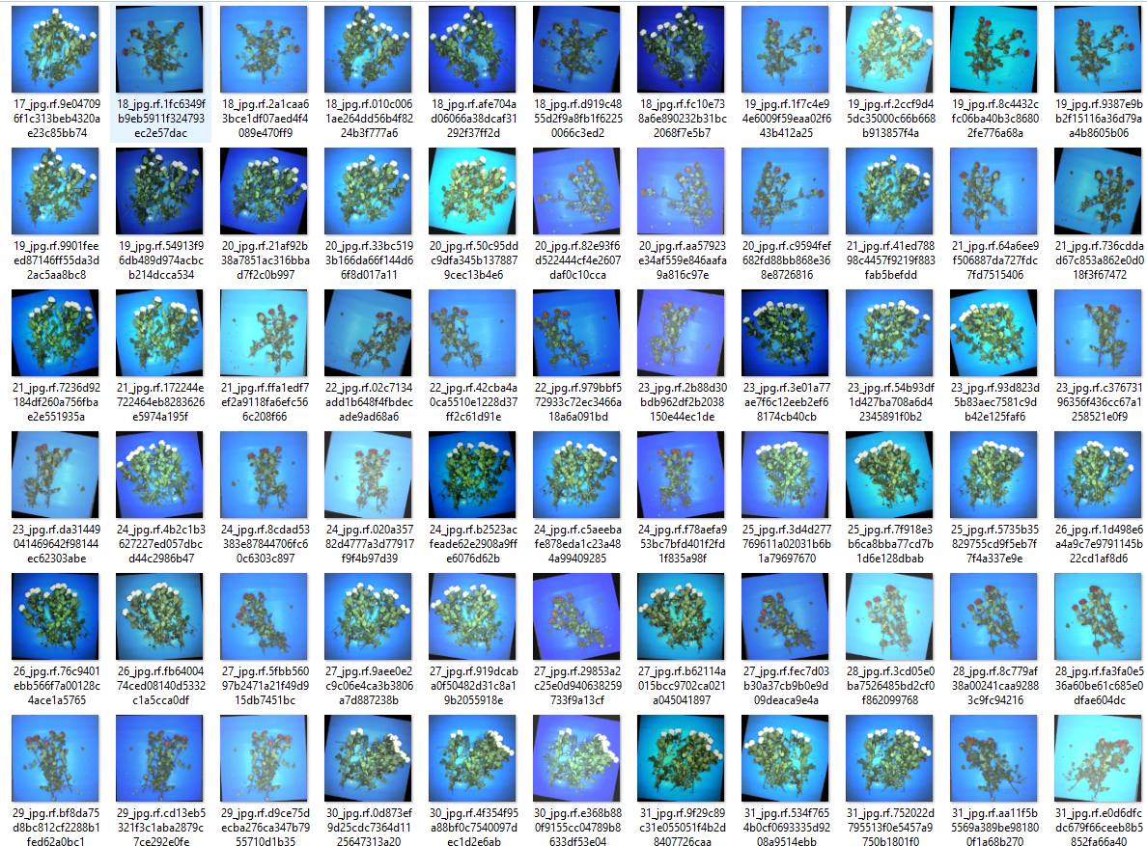
Tested the overall performance based on Sem’s dataset. (224 images)
! This experiment tests only the stem pairing algorithm given masks annotations

Slide 3
Ground Truth
Positive
Negative
Positive
'total_gt_clusters': 1282,
'total_pred_clusters': 1358,
'matched': 1239
'precision_matched': 0.9123711340206185,
'recall_matched': 0.9664586583463338,
'f1_matched': 0.9386363636363636,
'precision_mean': 0.8990786604391044,
'recall_mean': 0.9451226238283218,
'f1_mean': 0.9191995500242673,
TP
FP
Negative
Prediction
FN
TN
Recall: TP/(TP + FN) – accuracy in GT
Precision: TP/(TP + FP) – accuracy in Prediction
F1 Score = 2 * (Precision * Recall) / (Precision + Recall)
GT
IoU = overlapping area/ total area, precision is defined by IoU
Matched: The IoU between a GT flower stem and its prediction is larger than 0.5
Two clusters
P
Three clusters

Slide 4
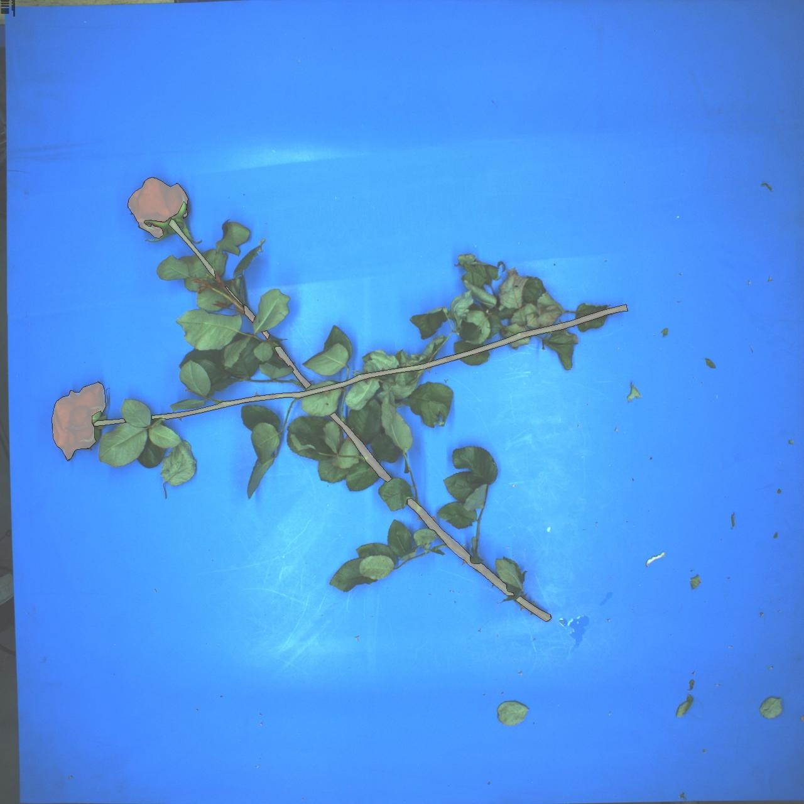
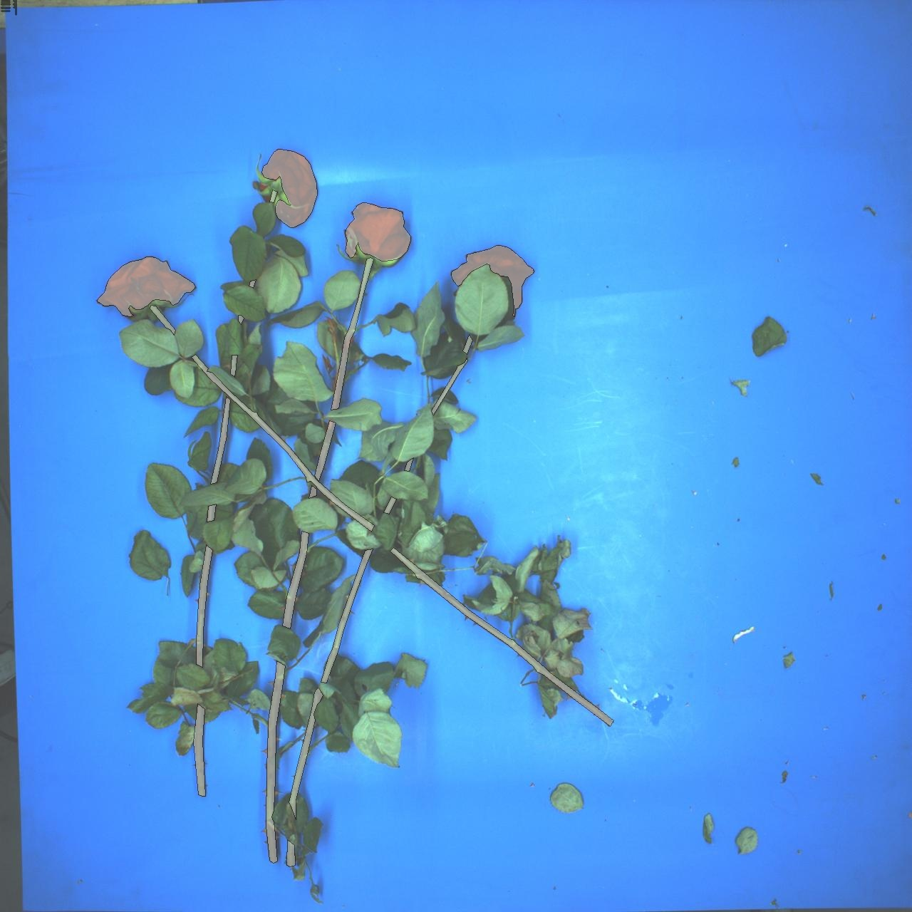
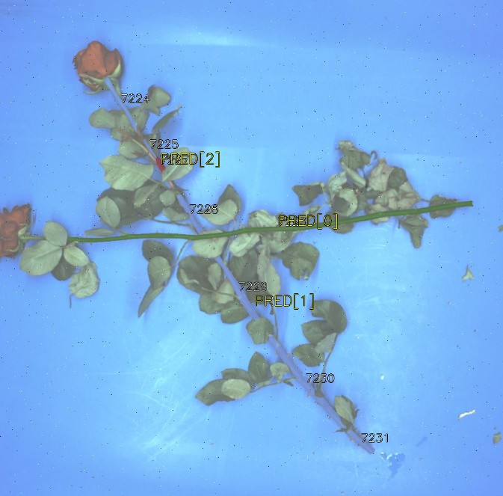
Outliers:

Slide 5
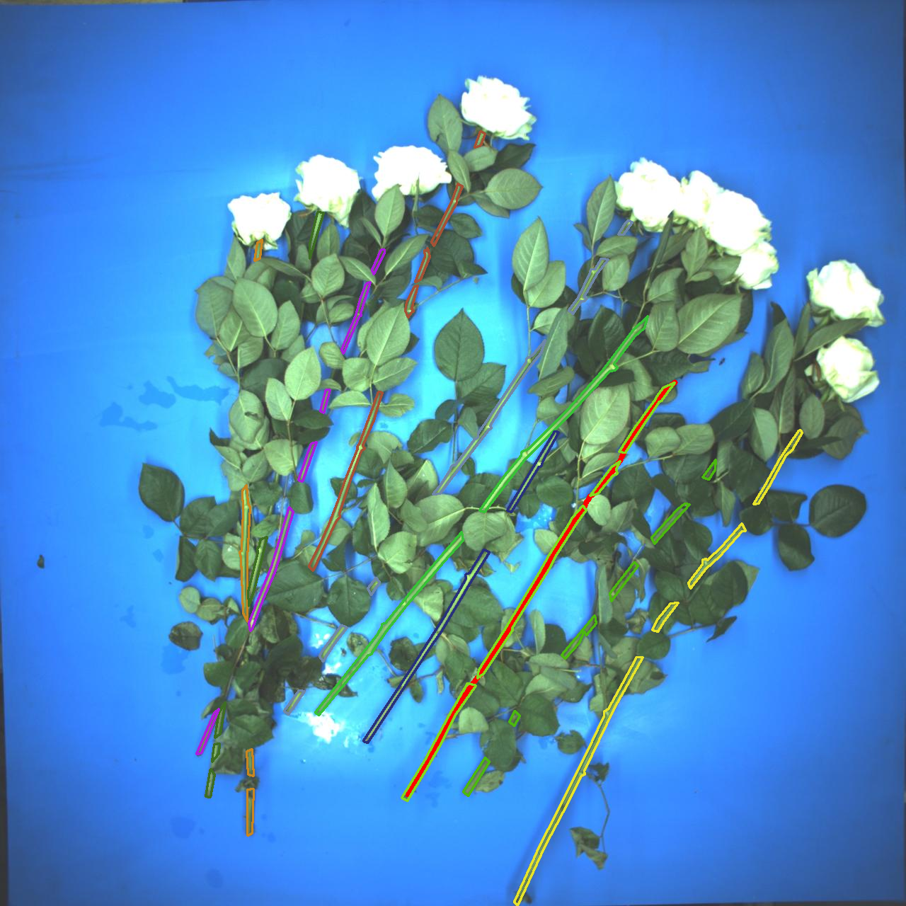
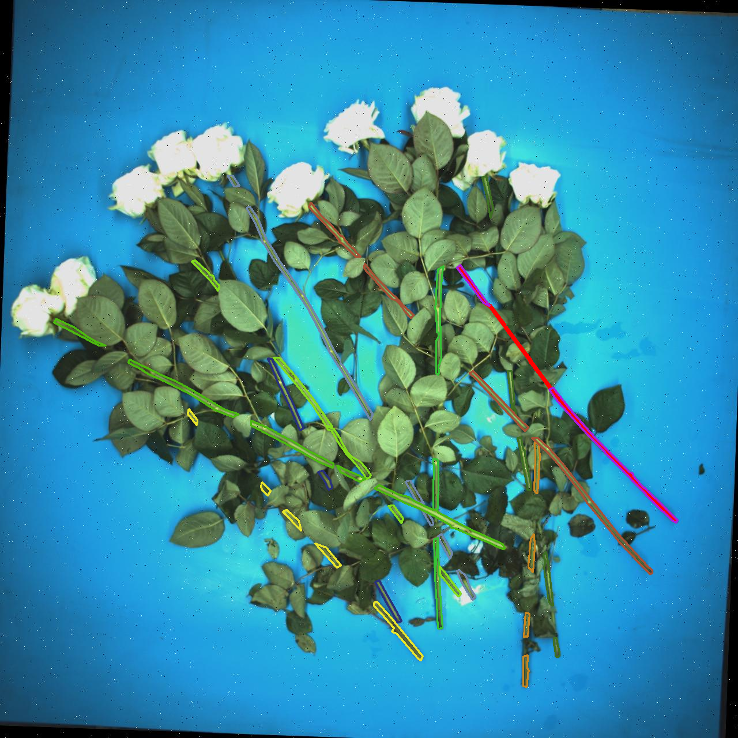
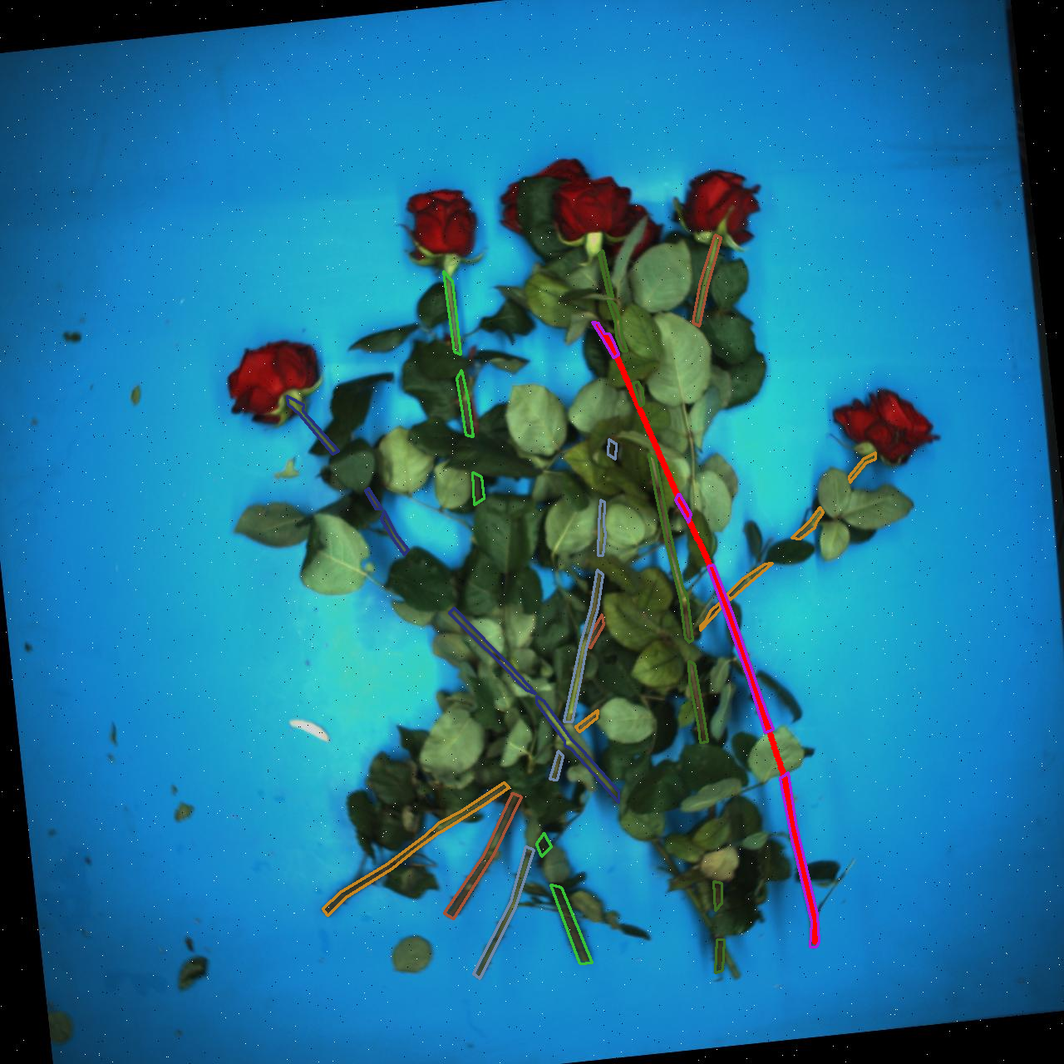
Top Selection algorithm developed by Zi,
Accuracy: 0.91, on 178 images, given the masks annotations and GT clusters

Slide 6
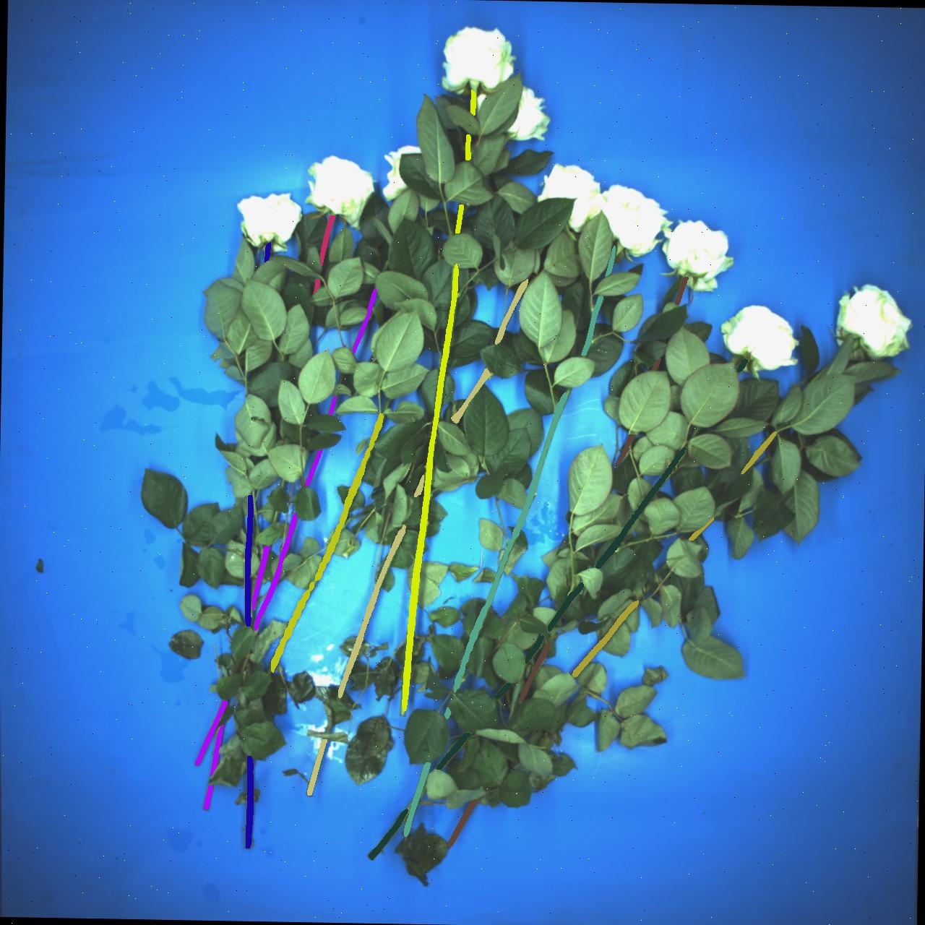
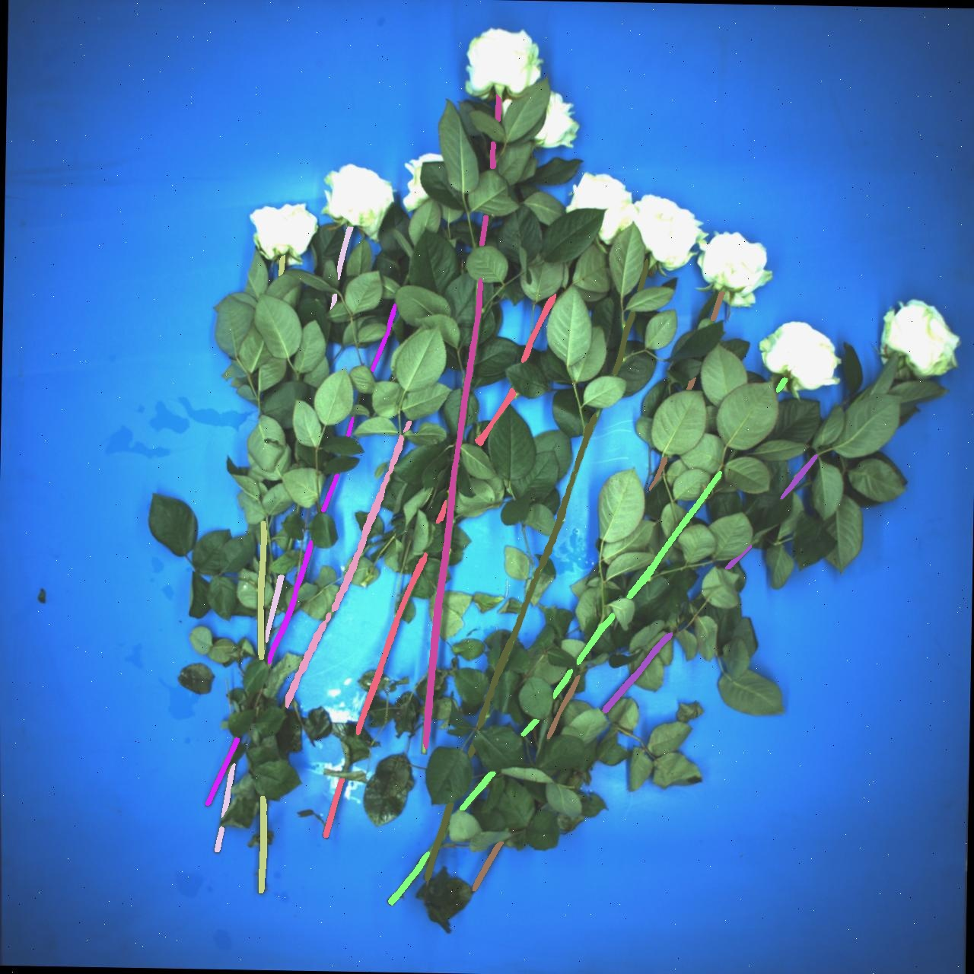
Add the profile information to stem pairing, solve the merge problem

Slide 7
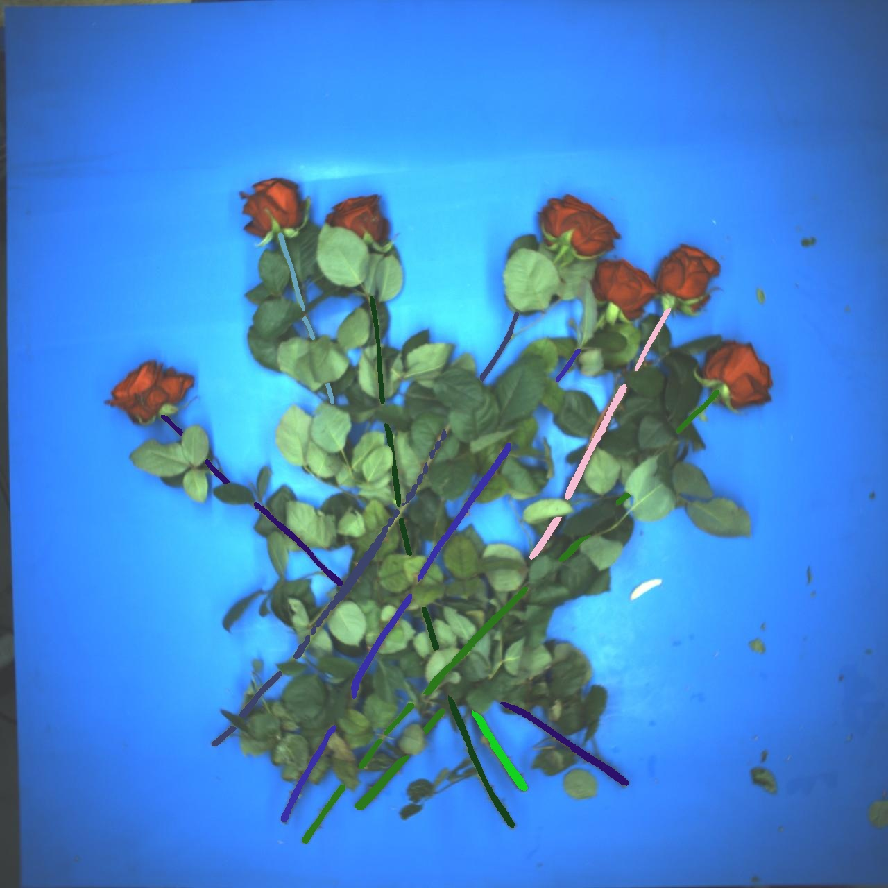
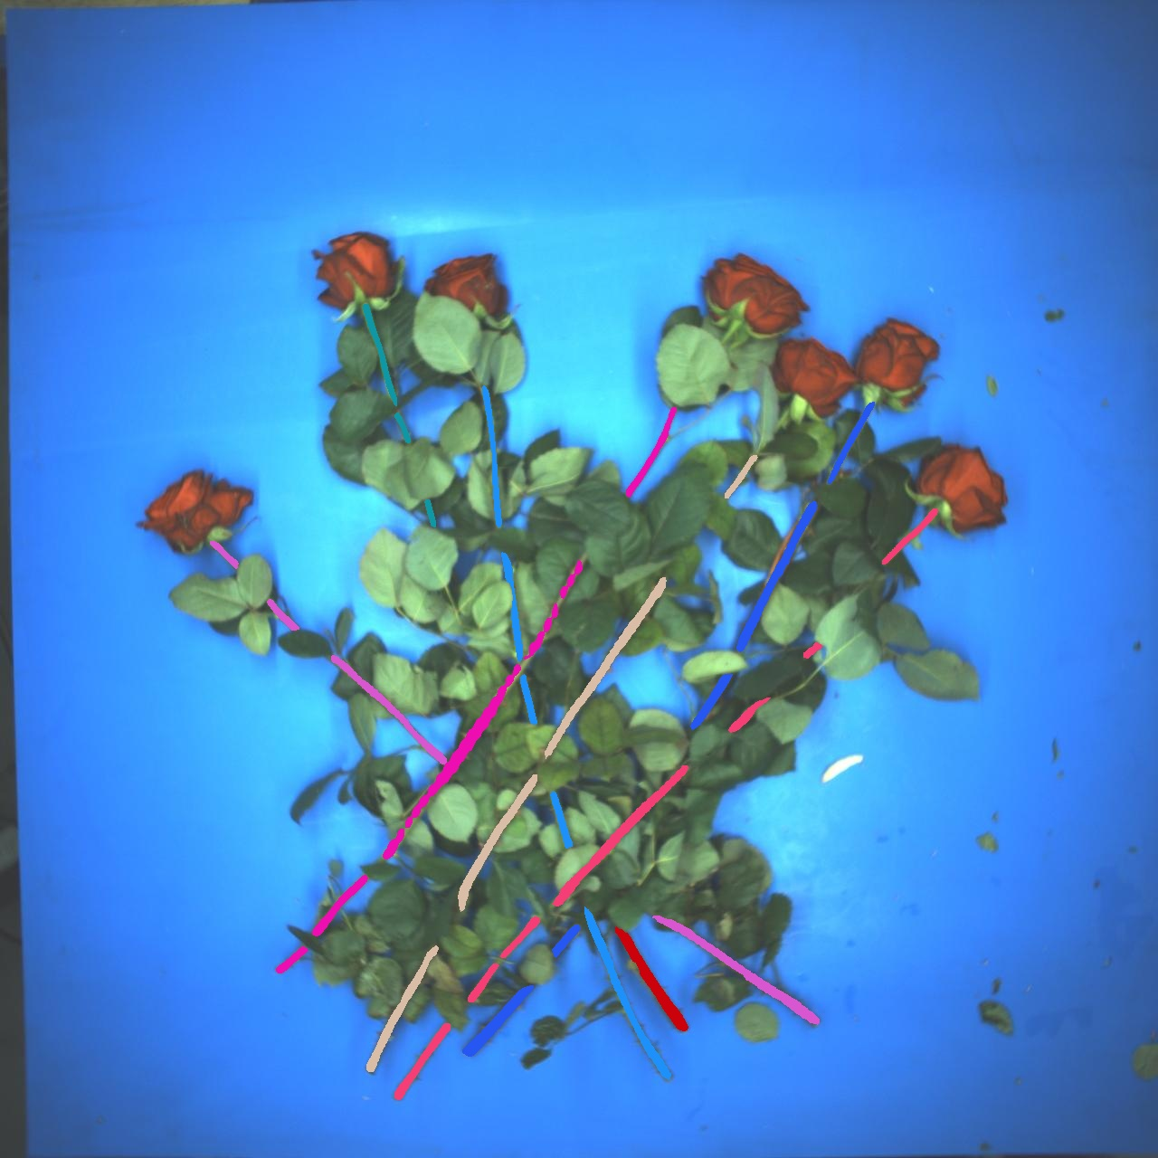
Add the profile information to stem pairing, solve the merge problem
Model Inderence: 2.1 s, Stem Pairing: 2.9 s

Slide 8
Future works：
1. Test the performance of the mask detection + stem pairing.
2. Merge the stem pairing algorithm with top selection algorithm.
3.Test the performance of the stem pairing + top selection algorithm
4.Test the performance of the whole pipeline (mask detection + stem pairing + top selection)
5. New dataset?

